Slide 1



[HITT, HANKINSON, ANDERSEN, D’SOUZA – RADAR]
GROUP 32

Slide 2




MEET THE TEAM
SHANNON HANKINSON
ELECTRICAL ENGINEERING
BAILEY HITT
ELECTRICAL ENGINEERING
RYAN ANDERSEN
ELECTRICAL ENGINEERING
JOSHUA D’SOUZA
COMPUTER ENGINEERING

Slide 3

PROBLEM STATEMENT
2HAD-RAD was developed to enhance search and rescue operations. The compact, multimodal system assists responders in locating individuals within its field of view in indoor and outdoor environments using coordinated radar, UWB localization, and thermal sensing.
  Battery powered handheld device integrating radar, ultra wide band (UWB), infrared (IR), inertial navigation, and ultra sonic sensing (USS)
  Detects human activity such as breathing, body heat and movement
  Real time processing and sensor fusion performed on an ESP32-WROOM32E microcontroller
  Generates high confidence detections and estimates 3D location using fused mmWave radar sensing and UWB based localization
  Visual user alerts are triggered when a detection threshold is met
  Logs positional data in the mobile application to provide responders with actionable search-and-rescue information

Slide 4

GOALS & OBJECTIVES
  Provide responder to victim distance estimation via UWB anchor–tag ranging at ≥ 3 m line-of-sight.
  Display detection results on an LCD interface.
  Detect a human subject at ≥ 2 meters line of sight using radar.
  Confirm presence with IR sensing at ≤ 1 meter within FOV.
  Provide relative localization within ≤ 2 meters using INS and barometric sensing.
  Display detection feedback within 5 seconds.
  Operate continuously for ≥ 2 hours on battery power.
  Improve fused localization accuracy to ≤ 1 meter outdoors by integrating GNSS with INS.

Slide 5
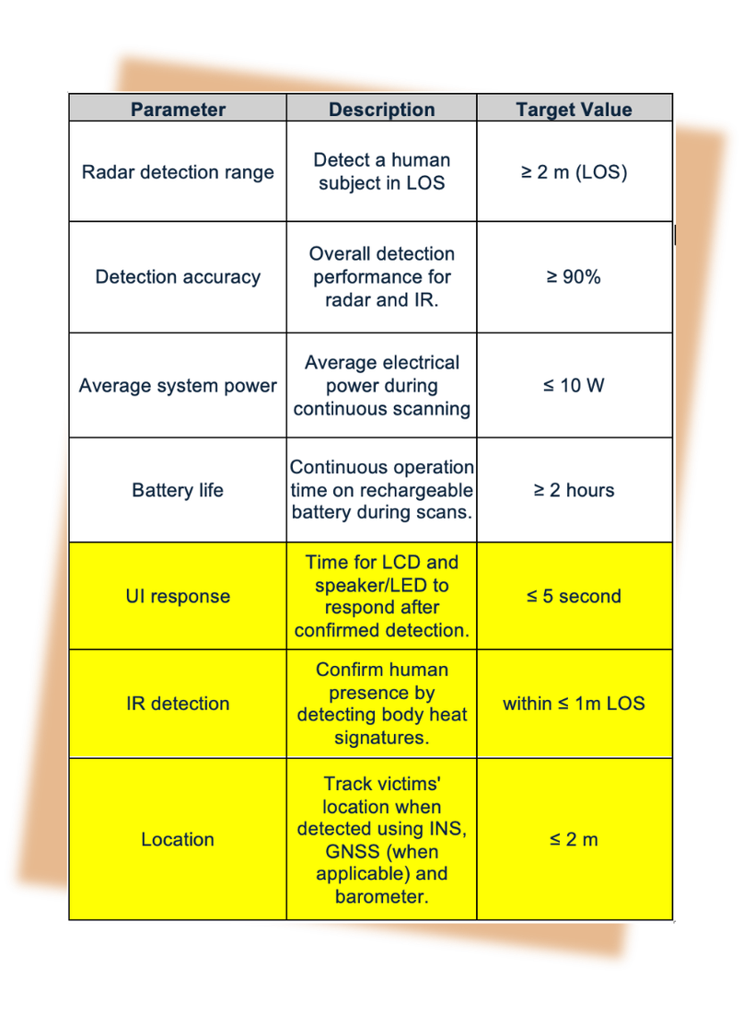
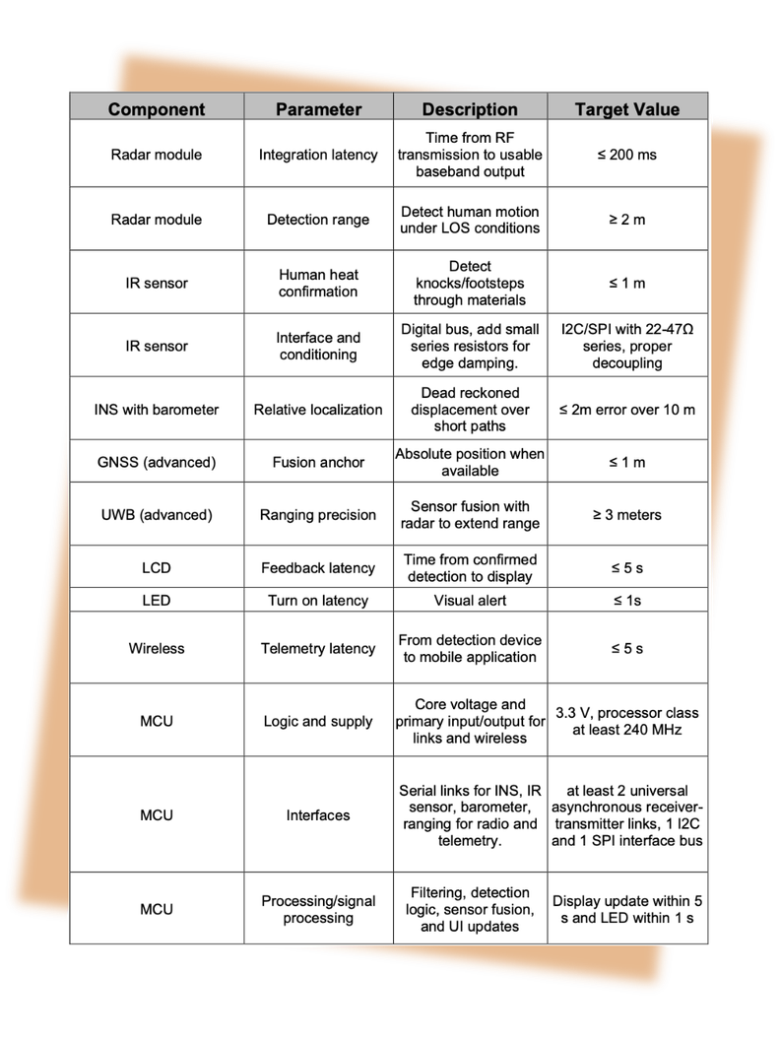
ENGINEERING SPECIFICATIONS

Slide 6
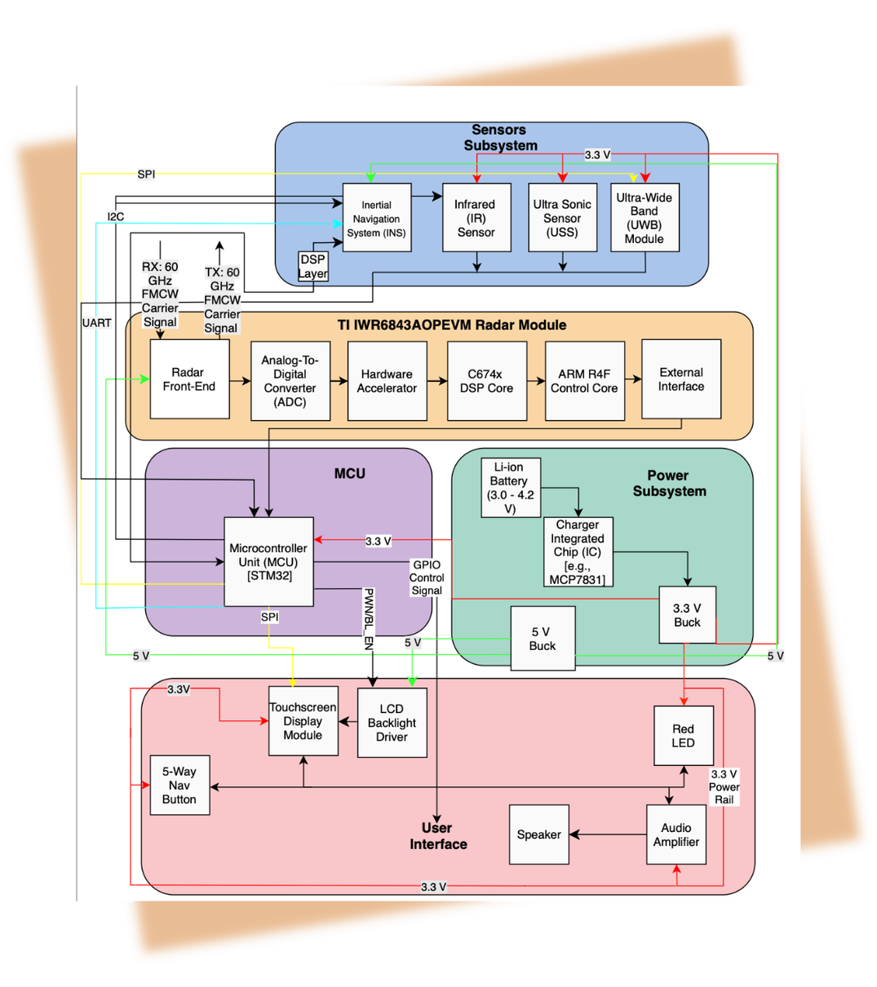
HARDWARE BLOCK DIAGRAM

Slide 7
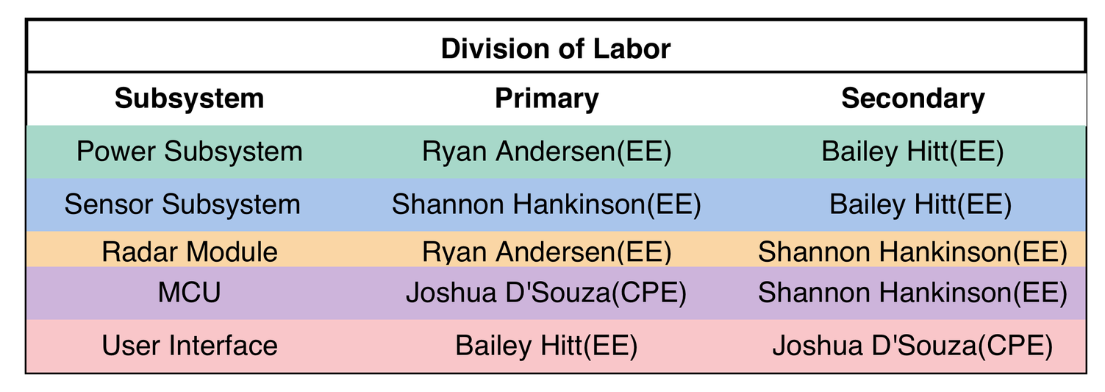
DIVISION OF RESPONSIBILITY

Slide 8
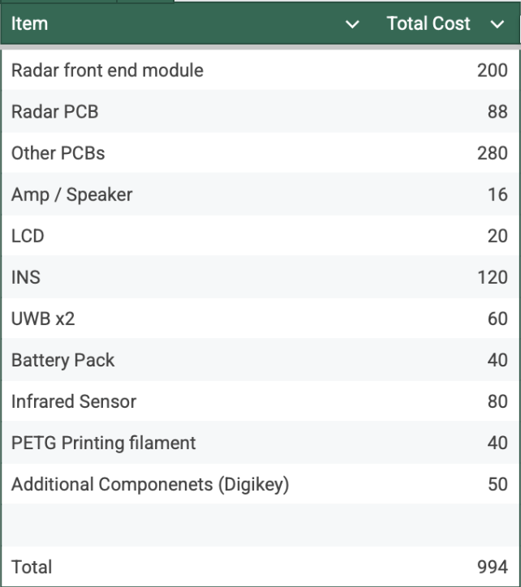
BUDGET

Slide 9
PERIPHERALS
Audio System
Amplifier & Speaker
Heat Detection
Infrared Sensor
Location Tracking
Ultra Wide Band Sensor (UWB)
Safety
Ultra Sonic Sensor
User Interface
LCD Screen

Slide 10
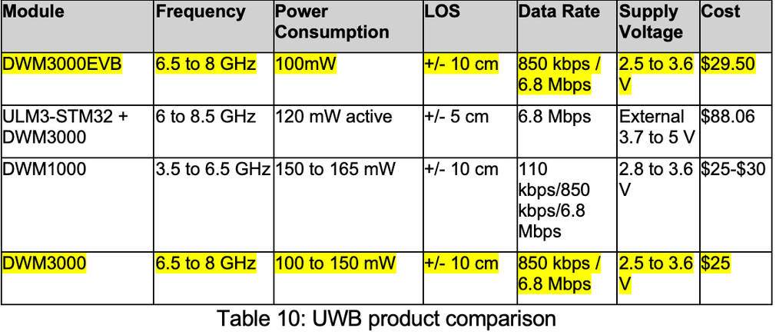
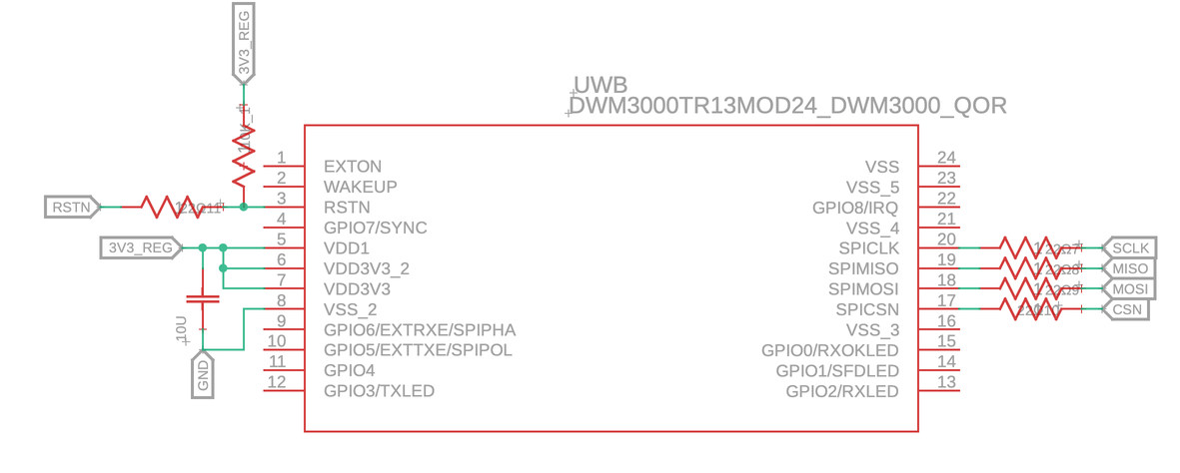
HARDWARE : UWB
  Provides positioning when GNSS is unavailable
  Handheld unit performs ranging and logs detections
  Mobile tag incorporated to act as a second handheld unit for demonstration purposes
  System measures the relative distance between units
  Provides estimated locations when GNSS is unavailable

Slide 11
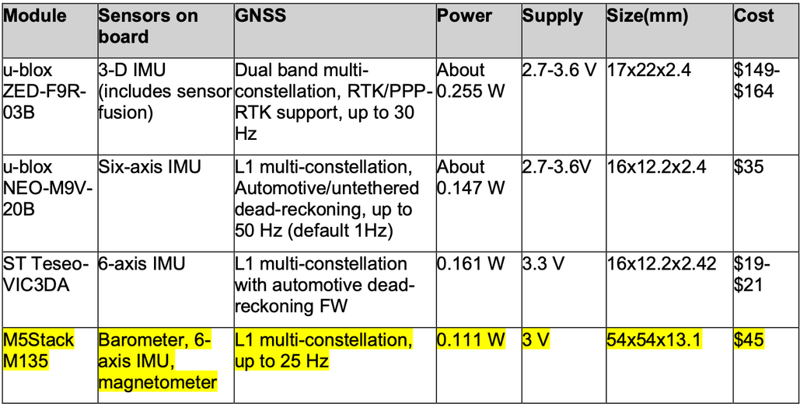
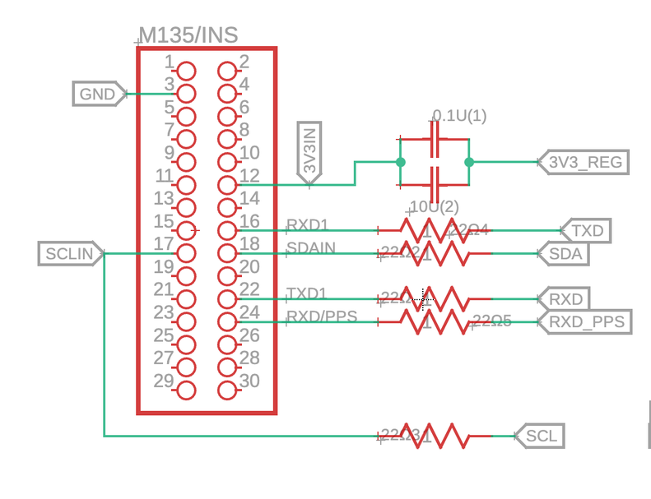
HARDWARE : INS
  Provides orientation, motion and position awareness
  Enables navigation when GPS is degraded or unavailable
  Supports victim location logging and responder tracking
  GNSS provides absolute position outdoors
  IMU maintains motion tracking when GNSS signal is lost
  Dead-reckoning estimates movement inside structures
  Barometer aids floor level estimation in multi-story buildings

Slide 12
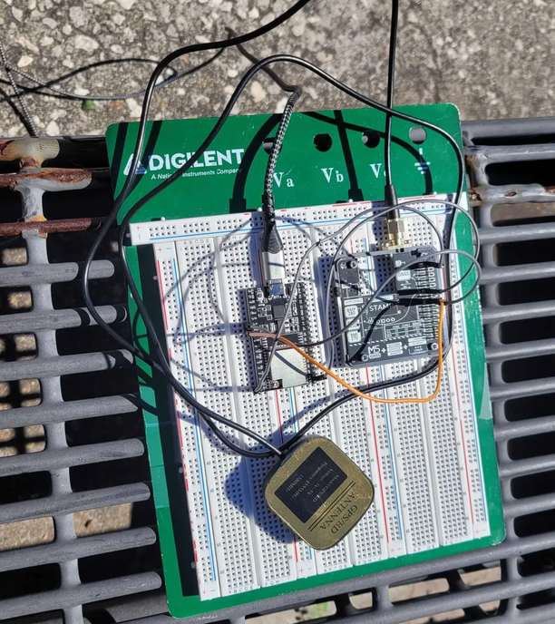
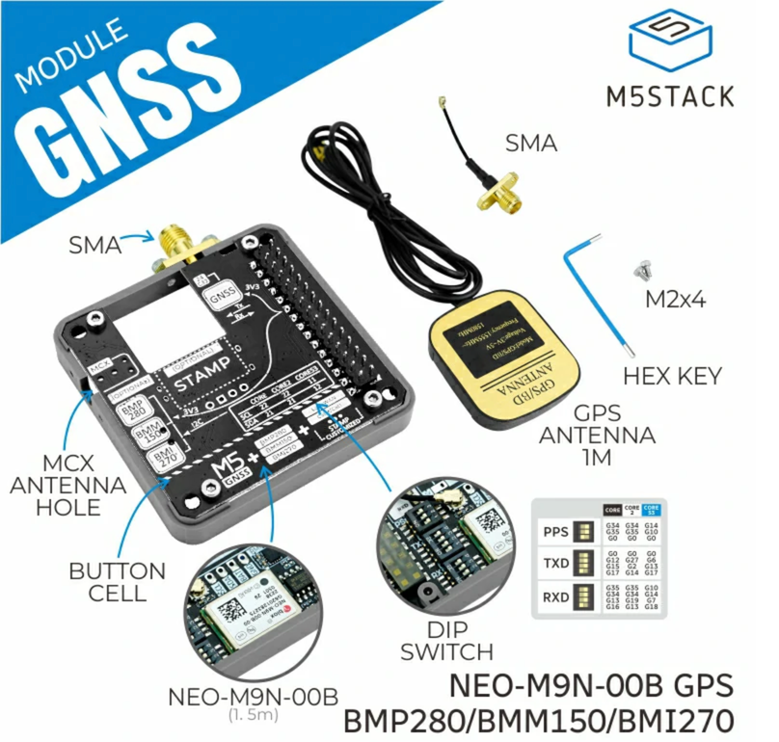
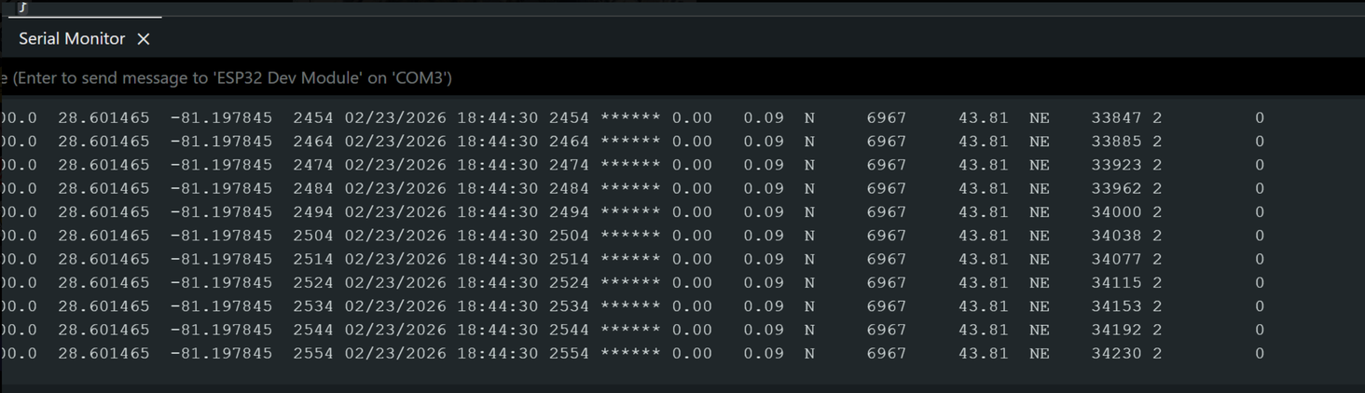
HARDWARE : INS

Slide 13
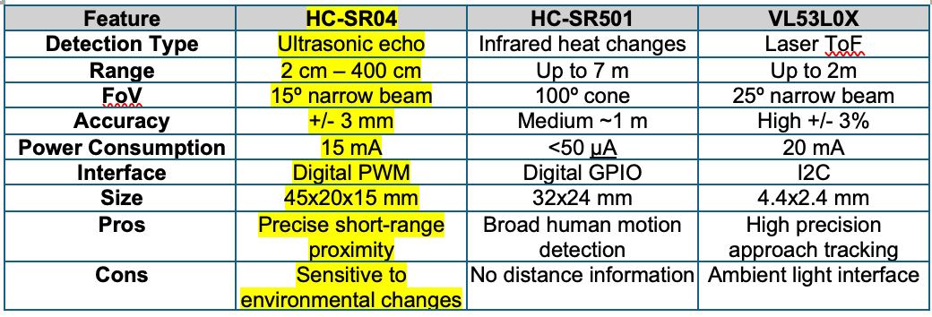
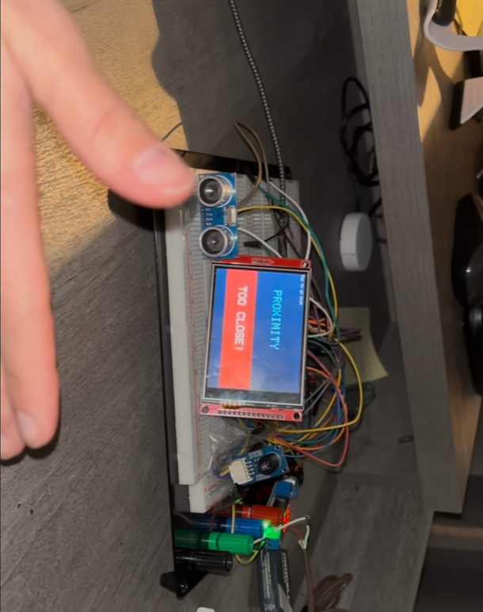
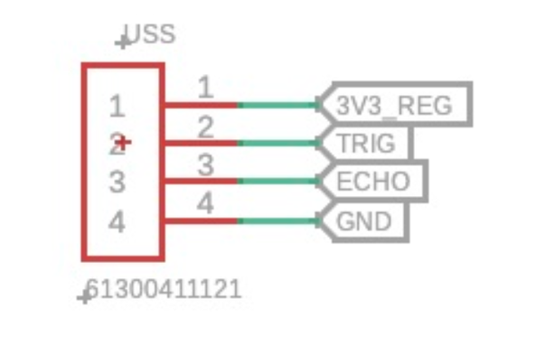
HARDWARE : USS
  Enforces a proximity safety interlock to disable radar within 22-30 cm to comply with FCC RF exposure regulation
  Provides a true distance measurement
  Alerts user when an object enter safety zone

Slide 14
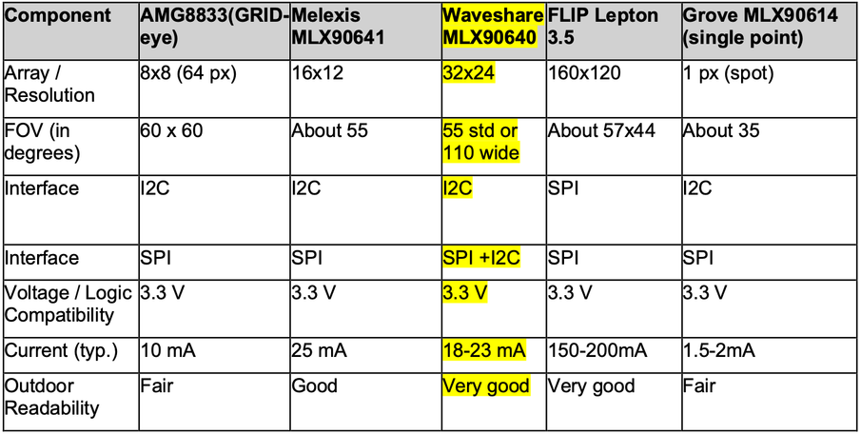
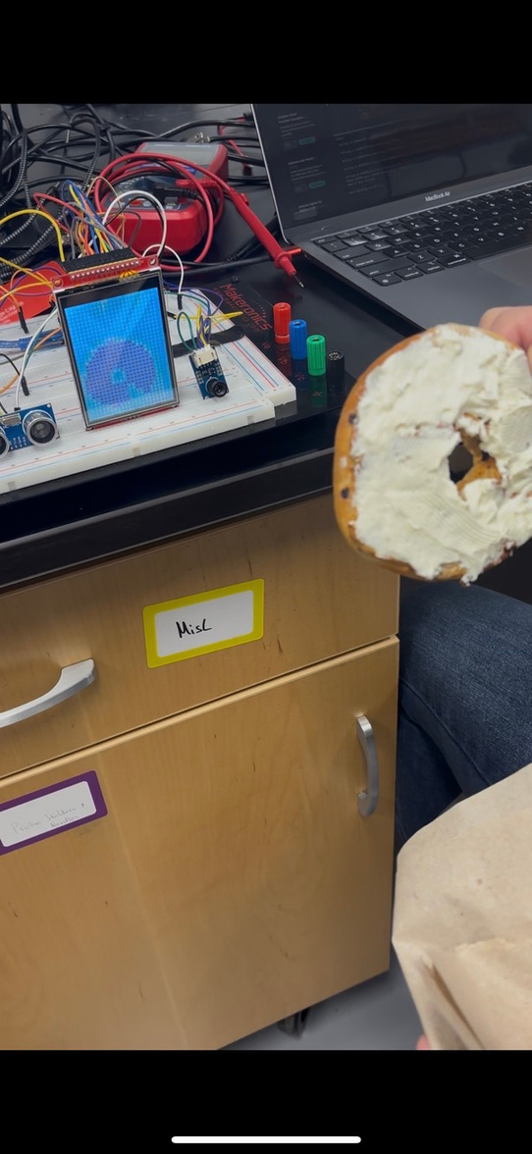
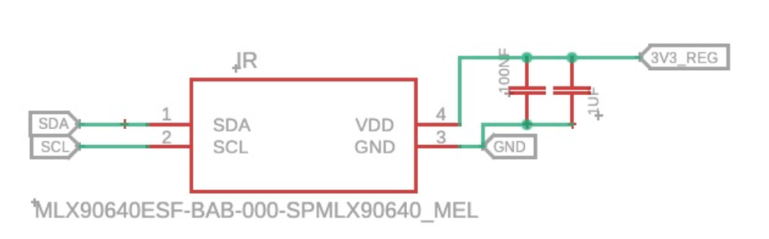
HARDWARE : IR
  Detects body heat signatures to confirm human presence
  Provides thermal visualization in low visibility environments
  Works without visible light
  Supports victim detection when radar signals are inconclusive

Slide 15
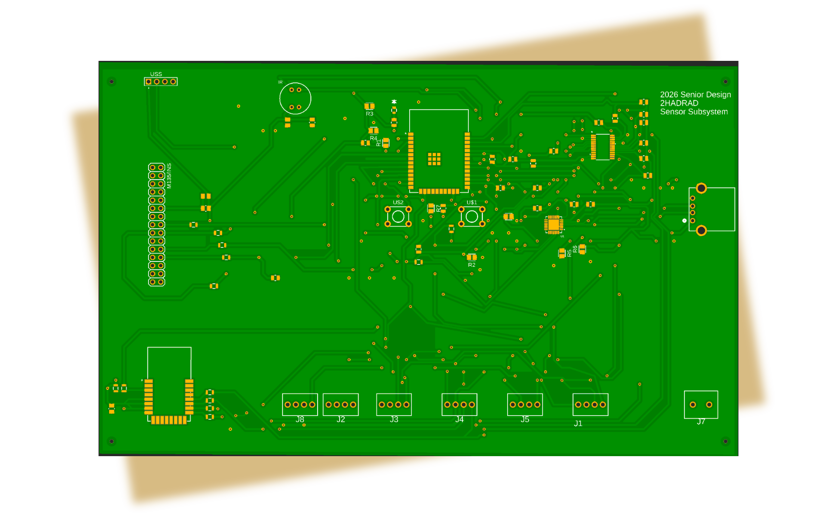
PCB: SENSOR SUBSYSTEM

Slide 16
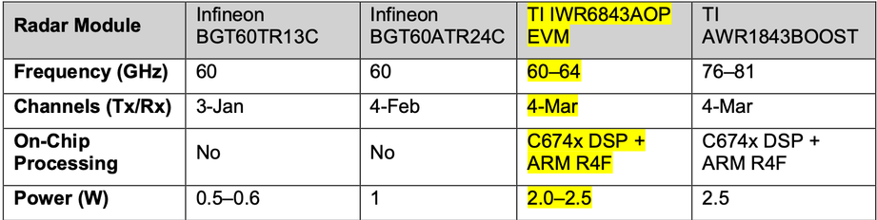
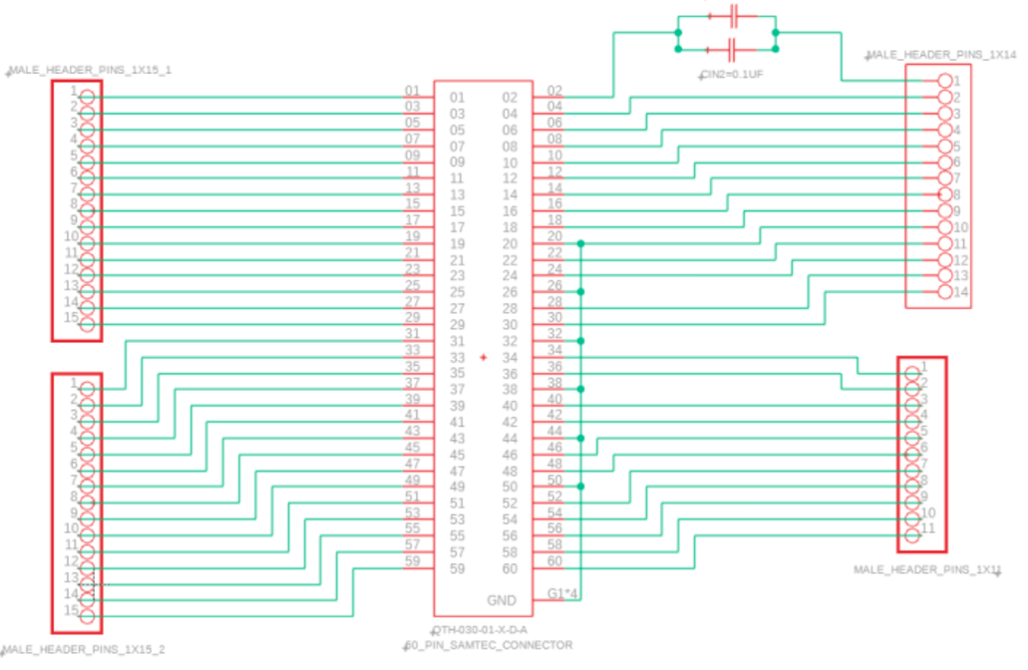
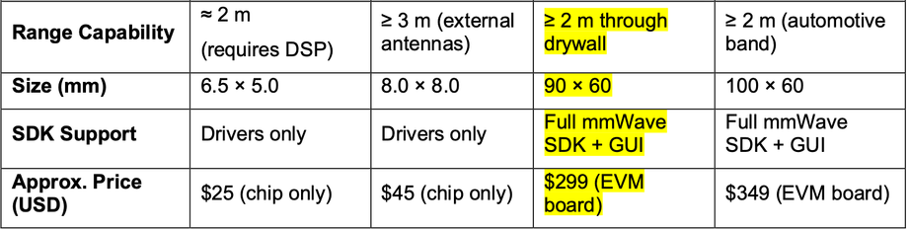
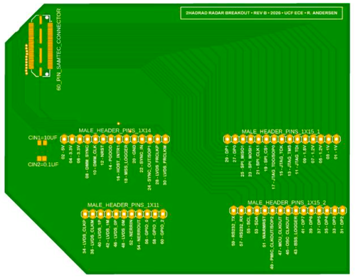
HARDWARE : RADAR

Slide 17
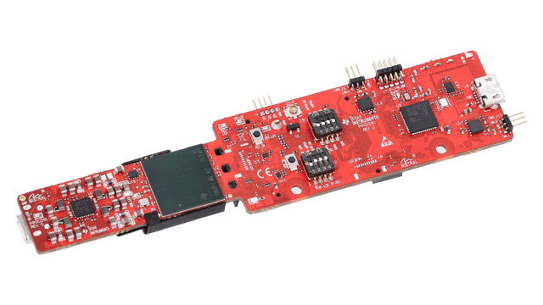
HARDWARE : RADAR
Integration with 2HADRAD:
  Electrical Interface:
    Connections required:
      5V Power
      GND
      Three UART lines
    UART Mapping:
      CLI RX (Radar RX ⟵ ESP32 TX)
        Used to send configuration file at startup
      CLI TX (Radar TX ⟶ ESP32 RX)
        Used for ACKs and status messages
      DATA TX (Radar TX ⟶ ESP32 RX)
        Streams processed TLV data continuously

Slide 18
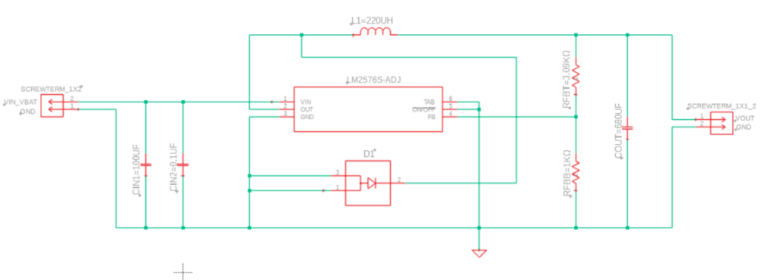
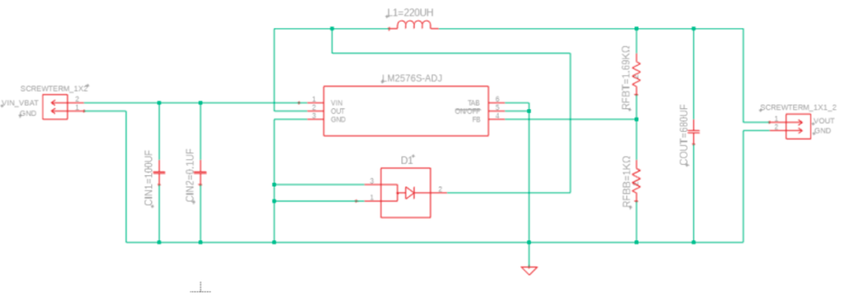
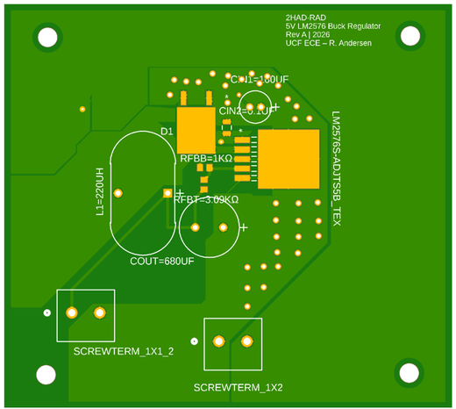

HARDWARE : REGULATORS

Slide 19
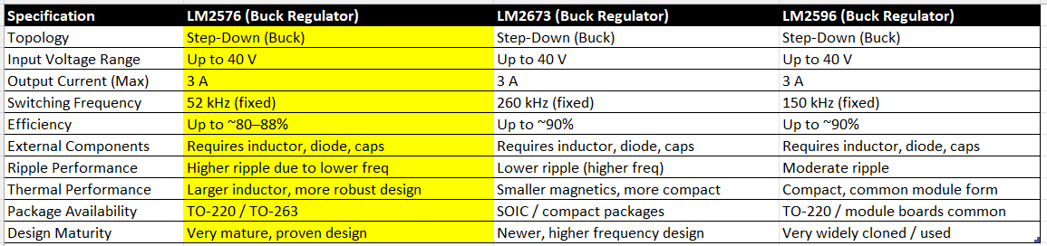
HARDWARE : REGULATORS
Why the LM2576 was selected:
  System requirements:
    3.3V rail and 5V rail (~1A peak with overhead each)
    Battery powered (3S Li-ion: 9-12.6V)
    High efficiency required for thermal and runtime constraints
  The LM2576:
    Wide input range (8V-40V)
    Up to 3A output capability
    Fixed-frequency switching (52 kHz) simplifies filter design
    High efficiency (>85-90%) under expected load

Slide 20
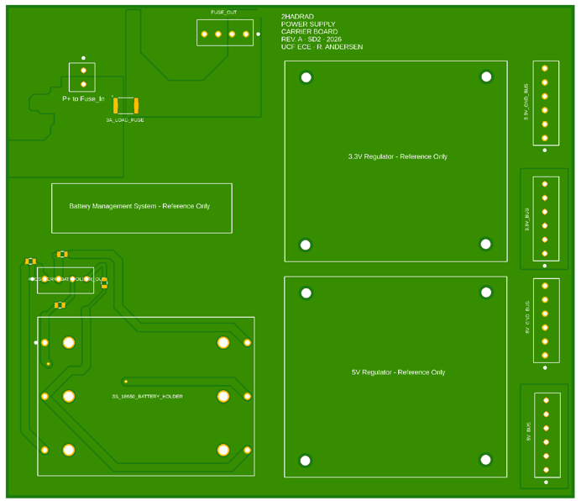
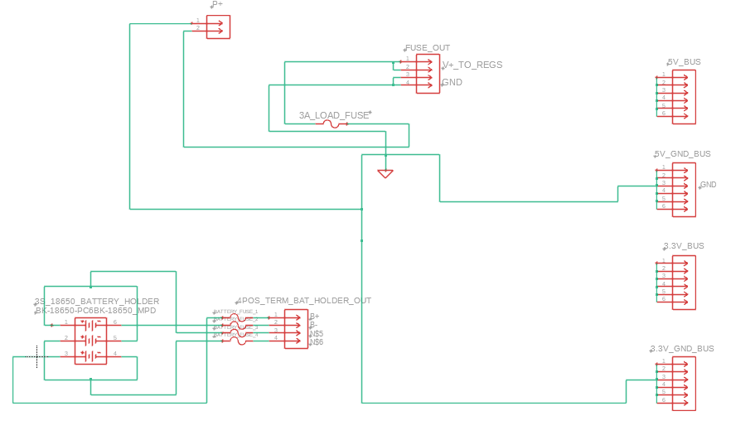
HARDWARE : POWER CARRIER BOARD

Slide 21
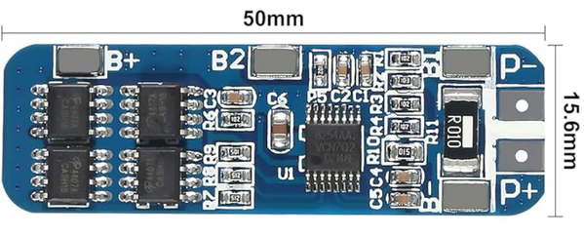
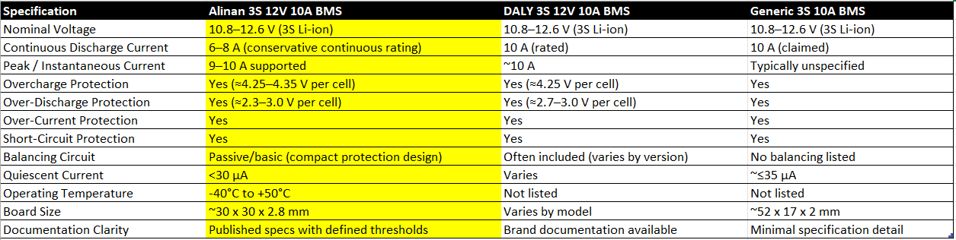
HARDWARE : POWER CARRIER BOARD
Battery, Protection, and Regulation Hub:
  Battery:
    3S 18650 Li-ion input (9-12.6V)
    Battery fuses for pack-level fault protection
    Commercial Battery Management System (BMS):
      Overcharge, over-discharge, overcurrent, and short circuit protection
  System:
    Load fuse protecting downstream electronics
  Regulation:
    Hosts 5V and 3.3V LM2576 buck regulators
    Converts battery power into stable rails for radar, ESP32, and peripherals

Slide 22
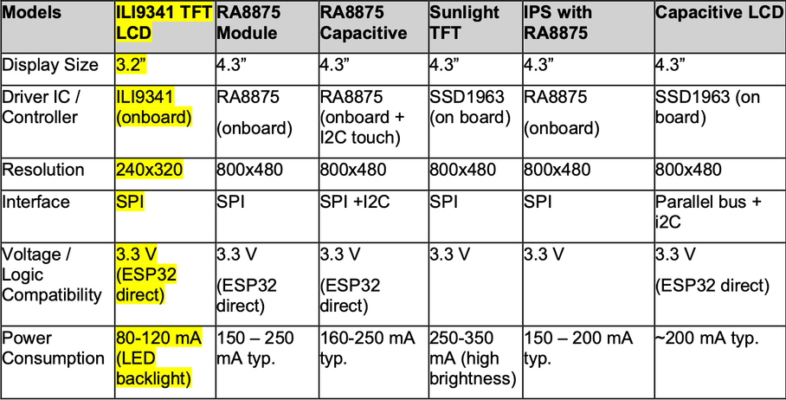
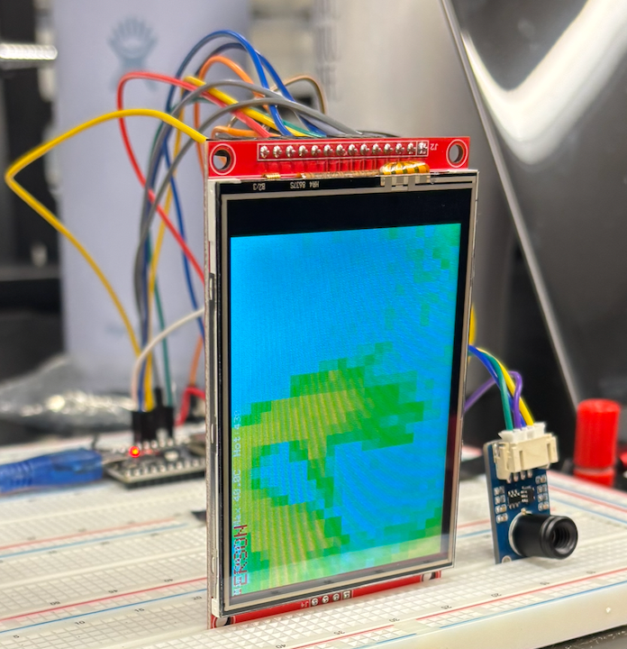
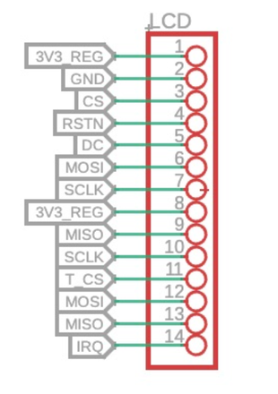
HARDWARE : LCD

Slide 23
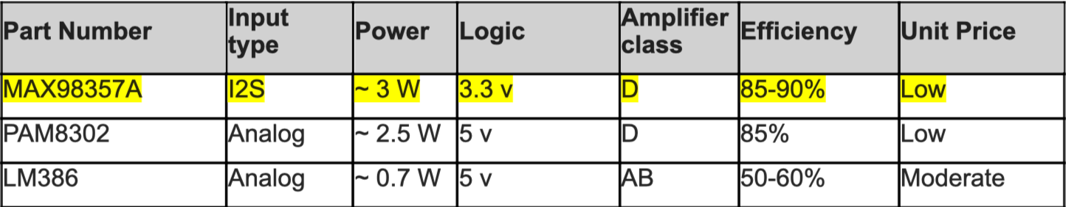
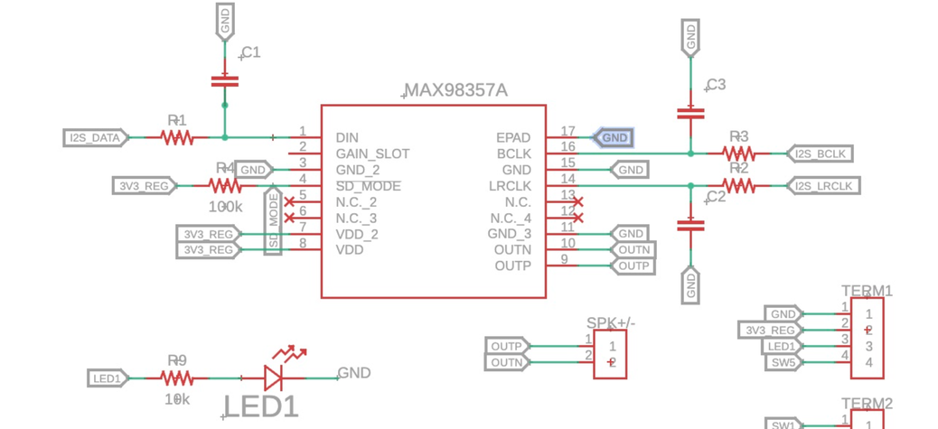
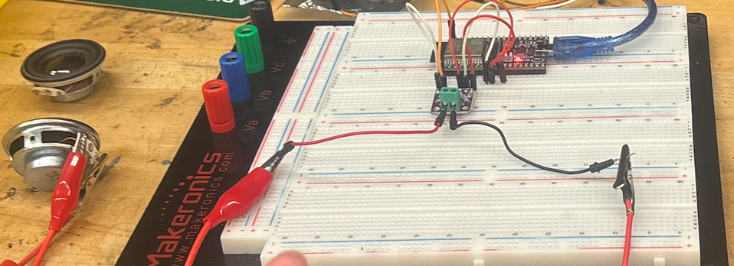
HARDWARE : AMPLIFIER

Slide 24
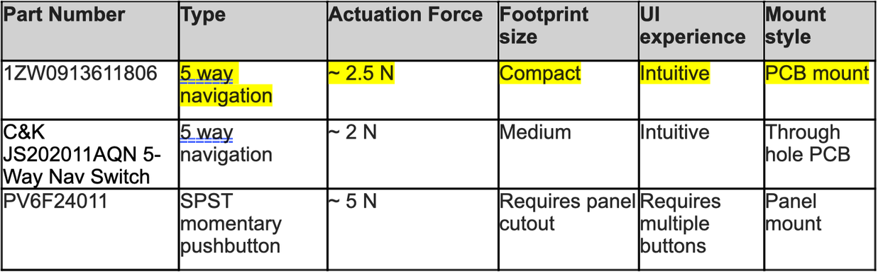
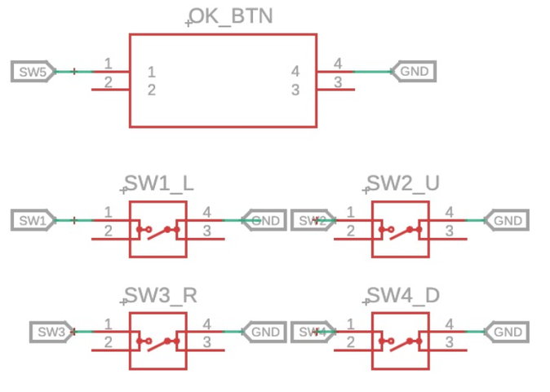
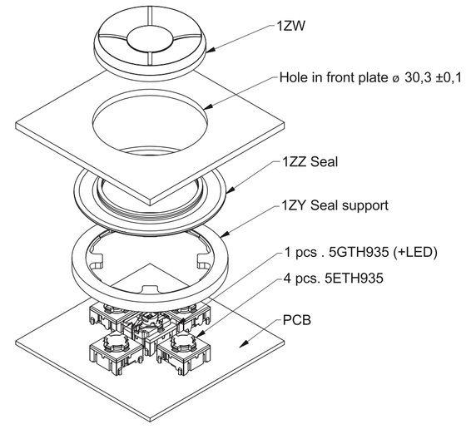
HARDWARE : BUTTON

Slide 25
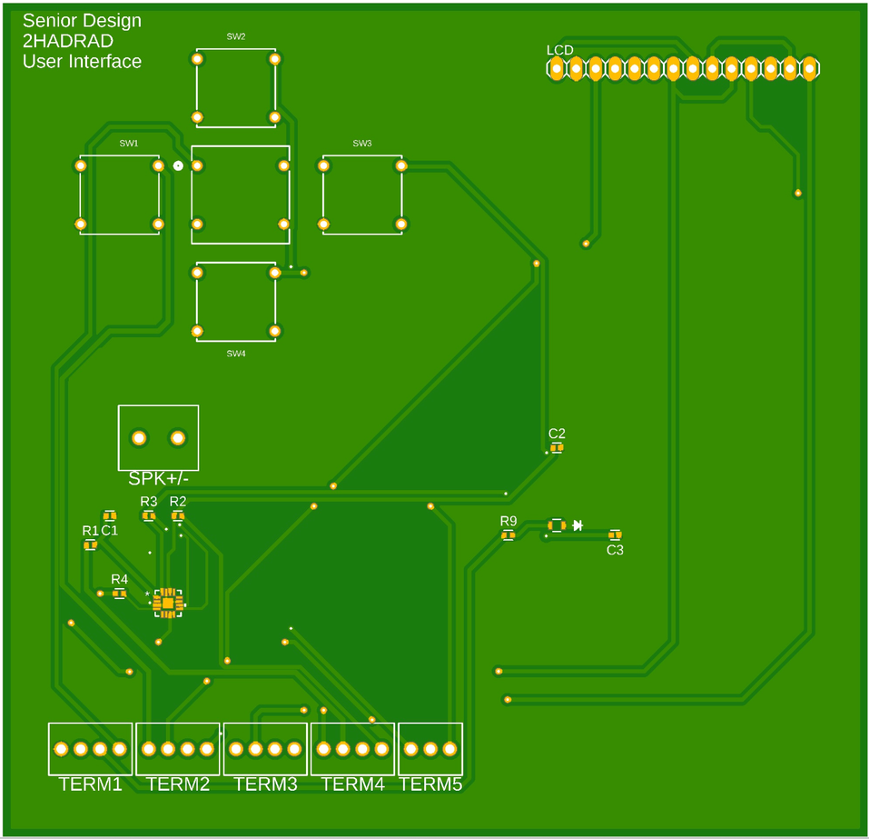
PCB: USER INTERFACE

Slide 26
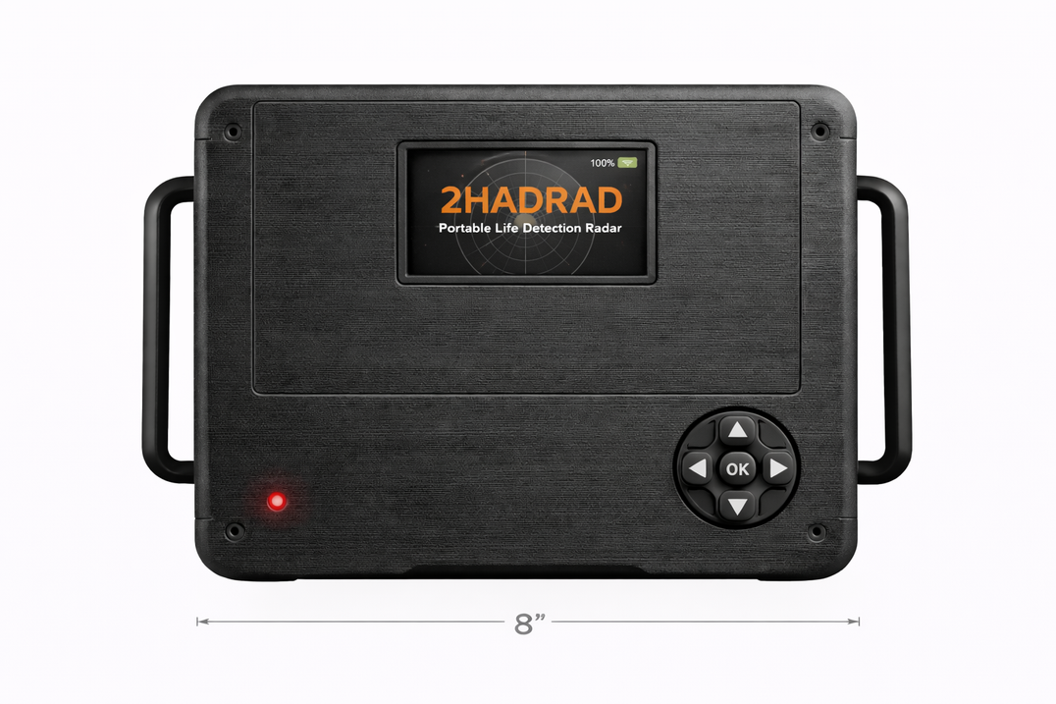
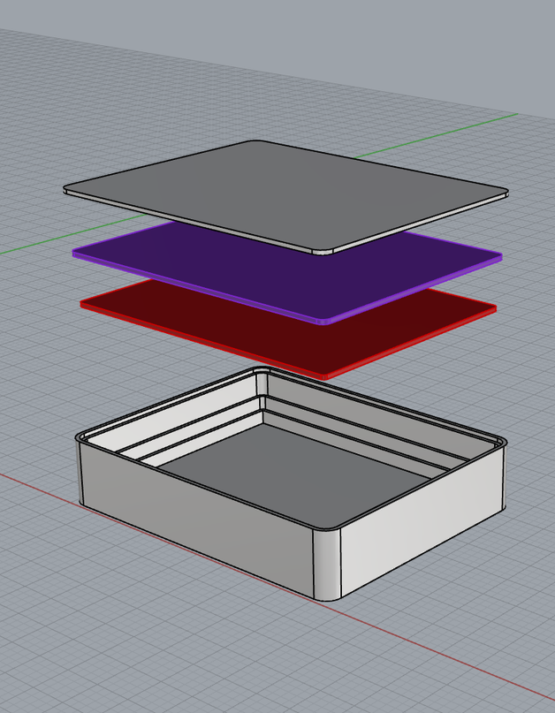
SYSTEM ENCLOSURE
  Stacked architecture separates UI, power and sensor subsystems to improve organization and serviceability.
  Dedicated PCB mounting plates provide mechanical stability and allow structured board spacing within the enclosure.
  Integrated cable routing pathway minimizes signal coupling and mechanical interference between sensitive RF/sensor lines.
  Ventilated top panel enables passive thermal management while maintaining proper sensor sight and antenna performance.

Slide 27
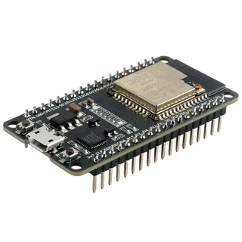
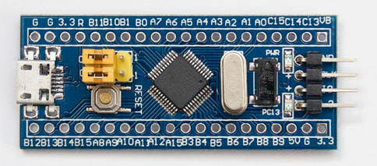
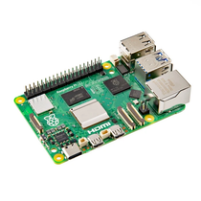
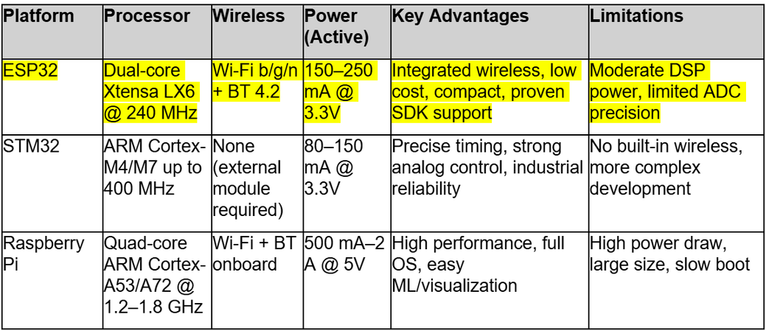
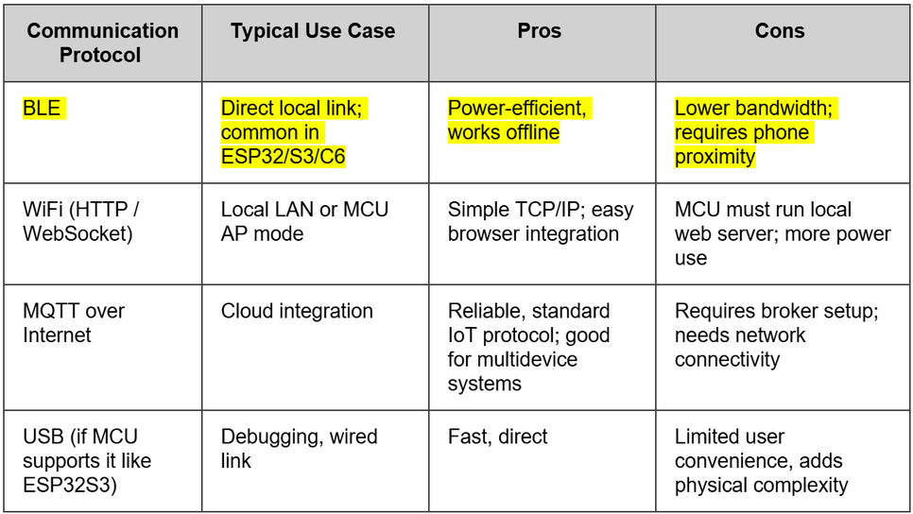
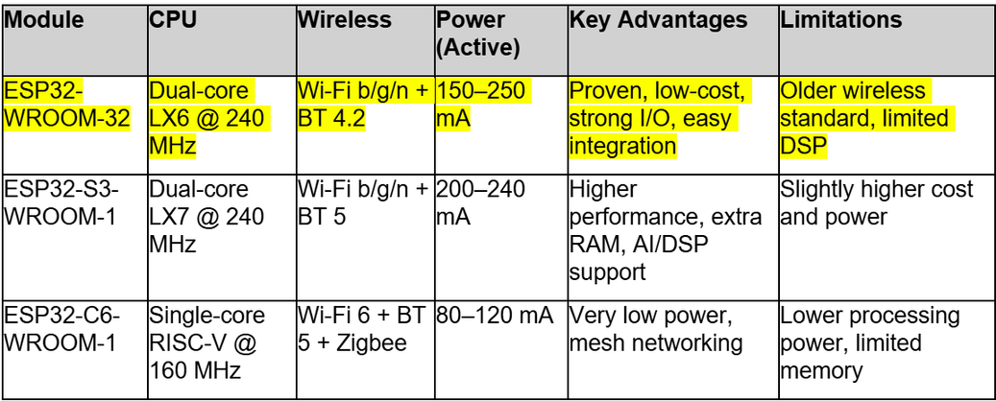




SOFTWARE SELECTION JUSTIFICATION
MCU
SMARTPHONE APP

Slide 28


SOFTWARE DESIGN

Slide 29


SOFTWARE DESIGN
UI FLOWCHART
USE CASE DIAGRAM

Slide 30



SOFTWARE DESIGN
RAW DATA AND HEATMAP UI
COORDINATE MAP UI

Slide 31

SOFTWARE DESIGN
SMARTPHONE APP UI

